Slide 1
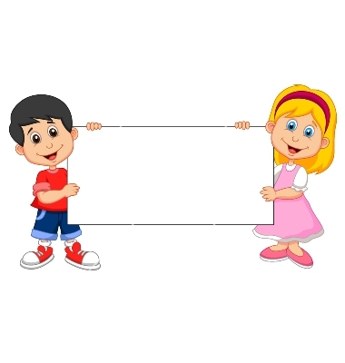


Donation
(Unable Piggybank)

Slide 2
Boys Version
Familiarization Task

Slide 3
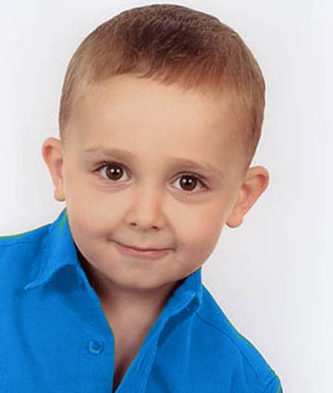
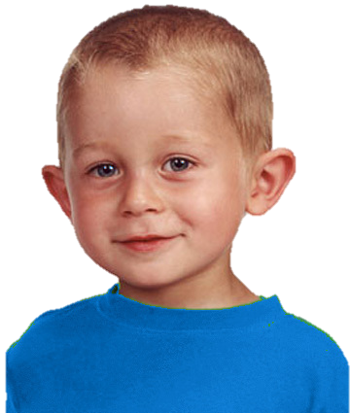
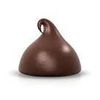
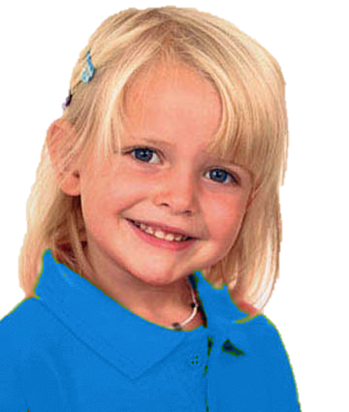
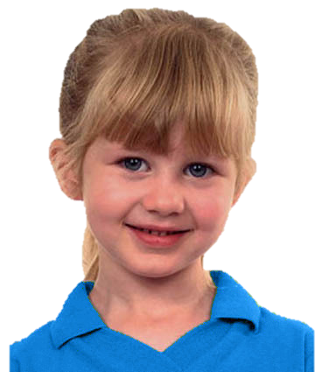
Introduce the group & the piggybank

Slide 4
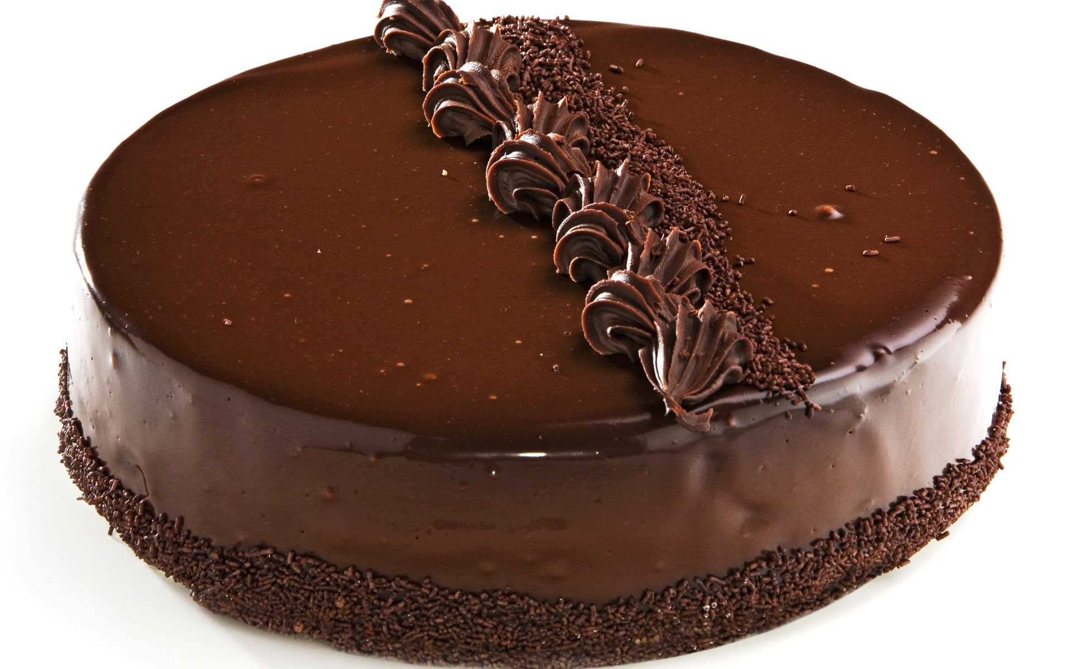
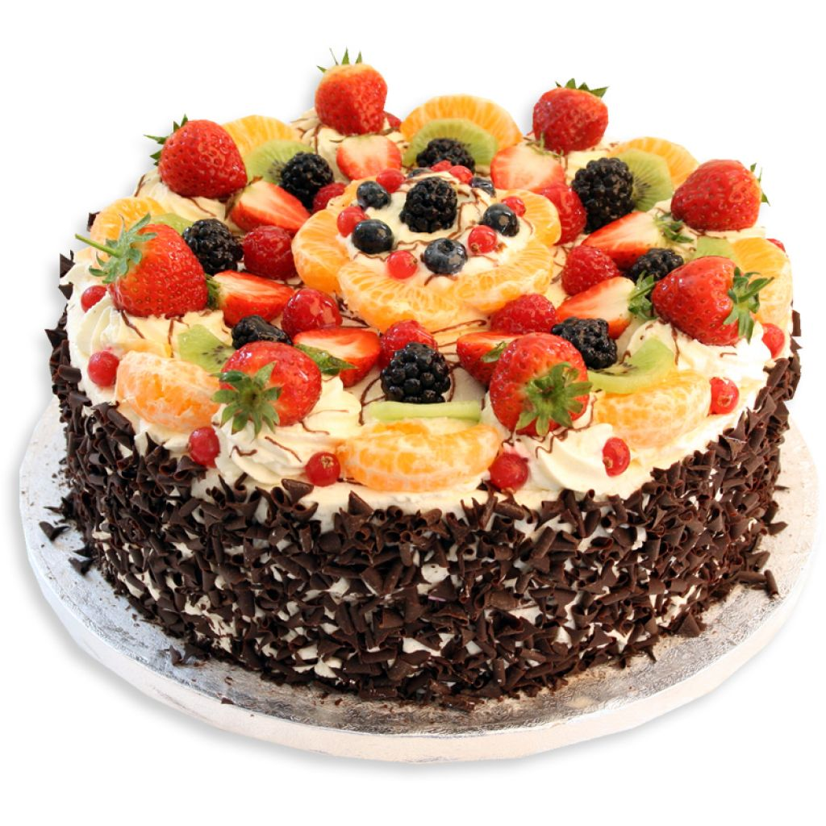
Explain how the piggybank works

Slide 5
Questions & feedback

Slide 6
Test Task

Slide 7
The group goal: have a big cake and share it

Slide 8
Unable free-rider (upper left):
He wants to put his chocolate in the piggybank. But a puppy comes and eats his chocolate. The other kids put their chocolate in the piggybank.

Slide 9
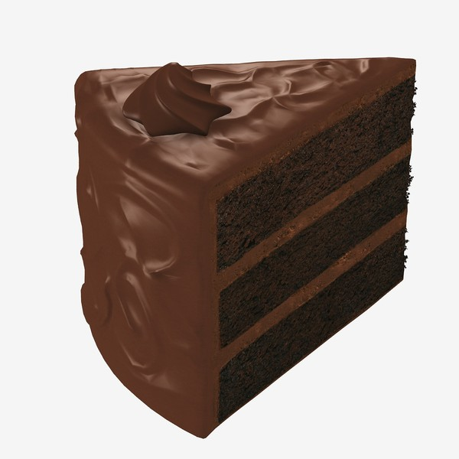
The outcome
The outcome: The piggy bank makes a small cake. Each kid gets a piece of it.

Slide 10
Test Questions
F
C

Slide 11
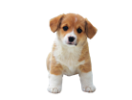
Unable Free-Rider Reminder:
He wants to put his chocolate in the piggybank. But a puppy comes and eats his chocolate. The other kids put their chocolate in the piggybank.

Slide 12

Evaluation: is he good or bad?

Slide 13
Evaluation: a little good/bad or really good/bad?

Slide 14


Preference: Do you like him or you don’t like him?

Slide 15


Preference: do you like him a little or a lot? do you kind of don’t like him or really don’t like him?
To Contributor

Slide 16
Contributor Reminder:
Wanted to put his chocolate into the piggybank and put it there.

Slide 17
Evaluation: is he good or bad?

Slide 18
Evaluation: a little good/bad or really good/bad?

Slide 19
Preference: Do you like him or you don’t like him?

Slide 20
Preference: do you like him a little or a lot? do you kind of don’t like him or really don’t like him?
To Free-Rider

Slide 21
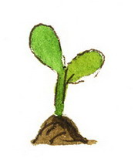
Donation
(Unwilling Plant)

Slide 22
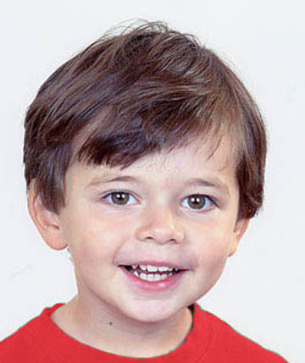
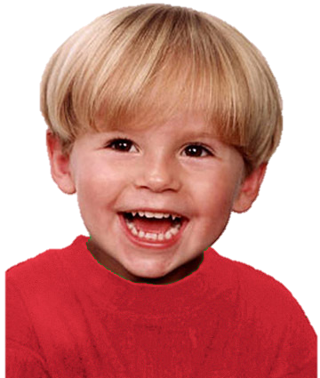
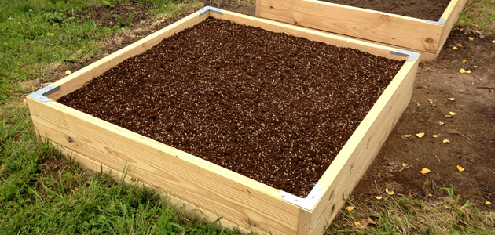
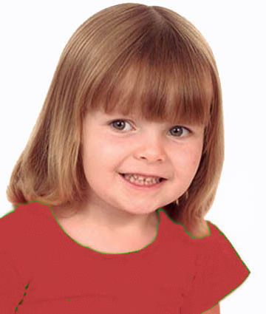
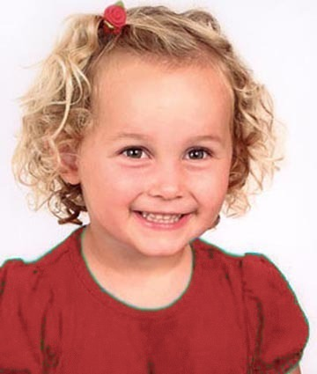
Introduce the group & the garden

Slide 23
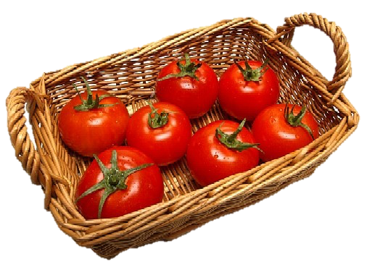
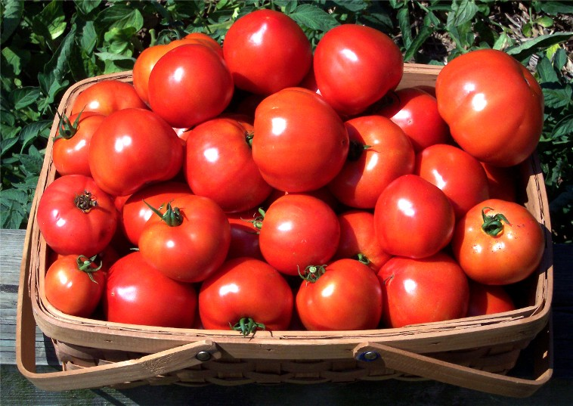
Explain how the garden works

Slide 24
Questions & Feedback

Slide 25
Test Task

Slide 26
The group goal: have a big basket of tomatoes and share them

Slide 27
He doesn’t want to put his plant in the garden. So he plants his at home (click for animation). The other kids put theirs in the garden (click for animation).
Notes:
The boy (on the upper right corner) wants to put his plant in the group garden,
but a rabbit comes to eat his plant

Slide 28
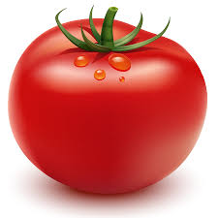

The outcome: They get a small basket of tomatoes. Each kid gets a tomato.

Slide 29
Test Questions
F
C

Slide 30
Test Questions
Free-rider

Slide 31
Unwilling Free-Rider Reminder:
He doesn’t want to put his plant in the garden. So he plants his at home. The other kids put theirs in the garden.

Slide 32
Evaluation: is he good or bad?

Slide 33
Evaluation: a little good/bad or really good/bad?

Slide 34
Preference: Do you like him or you don’t like him?

Slide 35
Preference: do you like him a little or a lot? do you kind of don’t like him or really don’t like him?
To Contributor

Slide 36
Contributor Reminder:
Wanted to put his plant in the garden and put it there.

Slide 37
Evaluation: is he good or bad?

Slide 38
Evaluation: a little good/bad or really good/bad?

Slide 39
Preference: Do you like him or you don’t like him?

Slide 40
Preference: do you like him a little or a lot? do you kind of don’t like him or really don’t like him?
To Free-Rider

